Slide 1
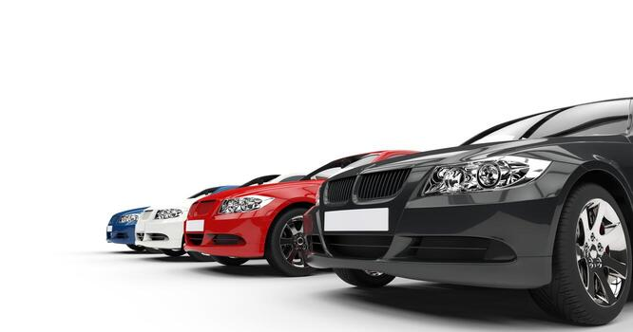

Tata Motors Global Car Sales
(2015–2024)
Presented By : Anjali Potu

Slide 2

Introduction to Tata Motors
Tata Motors is one of India's largest automobile company.
Manufactures passenger vehicles including EVs ,SUVs ,Hatchbacks & Sedans.
The company sells vehicles in many countries around the world.
Popular models include Nexon, Tiago, Harrier, and Altroz.

Slide 3
Project Objective
Analyze global car sales data from 2015–2024
Identify the best performing sales year & Top model
Understand the country-wise and Category-wise sales
Understand the unit sold country ,model & colour wise
Create interactive visualizations using Power BI

Slide 4
Delivery Days
Warranty years
Year
Dataset Overview
Country
Car Colour
Car Model
Payment Mode
Units Sold
Car Category

Slide 5

Scroller Visual
Top performing car model : Tigor
Unit Sold : 12,502,710
Highlights the most popular car in the dataset

Slide 6
Dashboard Slicers
Car Category Slicer
Car Colour Slicer
Year Slicer
Country Slicer
Warranty Years Slicer
These filters help users interact with the dashboard and analyze specific data.

Slide 7





Card Visuals
Sales Growth:11.09%
Card visuals are used to display single key values like total Sales, total units , etc.
Best Sales Year: 2022
Total Sales: 1,274,361.35M
Total Units Sold: 4,999,083
Average of Average Sale Price

Slide 8
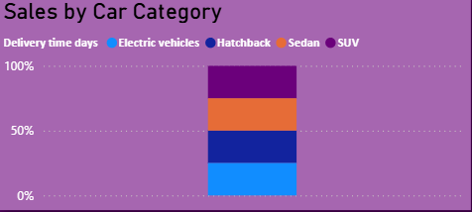
Sales by Car Category
100% Stacked column chart
Car Categories:
Electric Vehicles(EVs) : 25.19%
Hatchback: 24.87%
Sedan: 24.96%
SUVs: 24.98%
Sales distribution across categories
Strong growth of electric vehicles.

Slide 9
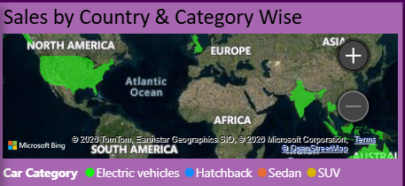
Sales by Country & Category Wise(Map)
Fill map visual
Shows global distribution of sales
Regional performance
Category presence in different countries

Slide 10
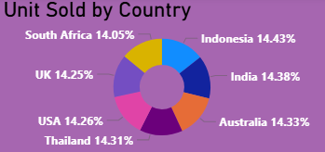
Unit Sold by Country
Donut chart visual
Percentages contribution by each country
India : 14.38%
USA : 14.26%
Uk : 14.25%
Indonesia :14.43%
Australia : 14.33%
Thailand : 14.31%
South Africa : 14.05%

Slide 11
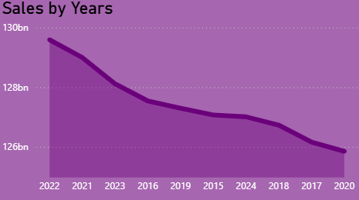
Sales by years
Area chart visual
Displays the trend of sales across different years
The highest sales year is 2022
Slight decline peak

Slide 12
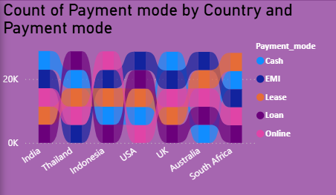
Payment Mode Analysis
Ribbon Chart Visual
Shows customer payment preferences such as Cash, EMI, Loan, Lease, and Online.
Count of payment mode by country and payment mode.
Most of the customers preferred EMI & Loan Payment Method used

Slide 13
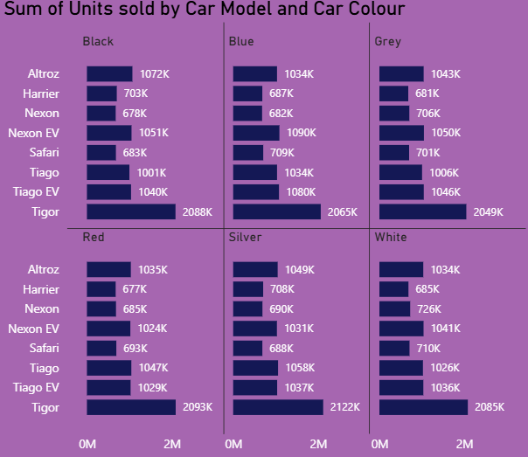
Units Sold by Car Model and Colour
Bar Chart Visual
Shows how different car colours perform across various car models.
Popular colour choices
Model wise unit sold
The highest sold model is Tigor (12502K)
The lowest sold model is Harrier(4141K)

Slide 14
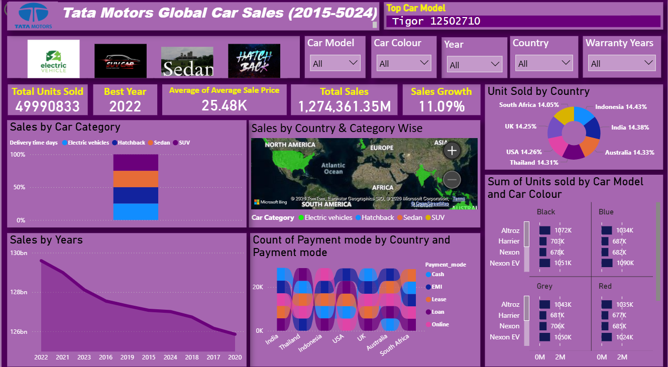
Dashboard overview

Slide 15
Insights & Recommendations
Insights
Peak sales achieved in 2022
Tigor is the top selling model
Sales show overall positive growth
SUVs & EVs are gaining popularity
Customers prefer EMI/ Cash payment options
Recommendations
Focus on High performing models
Expand electric vehicle & Invest more in EVs development
Improve low performing years
Promote SUVs & EVs aggressively & use digital marketing for better reach

Slide 16
Conclusion
This Power BI dashboard helps analyze Tata Motors global car sales.
It provides insights into sales trends, country distribution, and customer preferences.
Interactive visuals make data easier to understand and support business decision-making.

Slide 17


